Slide 1
SQL Joins
Oracle and ANSI Standard SQL

Slide 2
SQL Joins
Join Types
Inner join or equijoin
  Surrogate keys
  Natural keys
Non-equijoin
Outer join
Full outer join
Self join
Join behavior inheritance tree
Copyright 2006
Page <number>

Slide 3
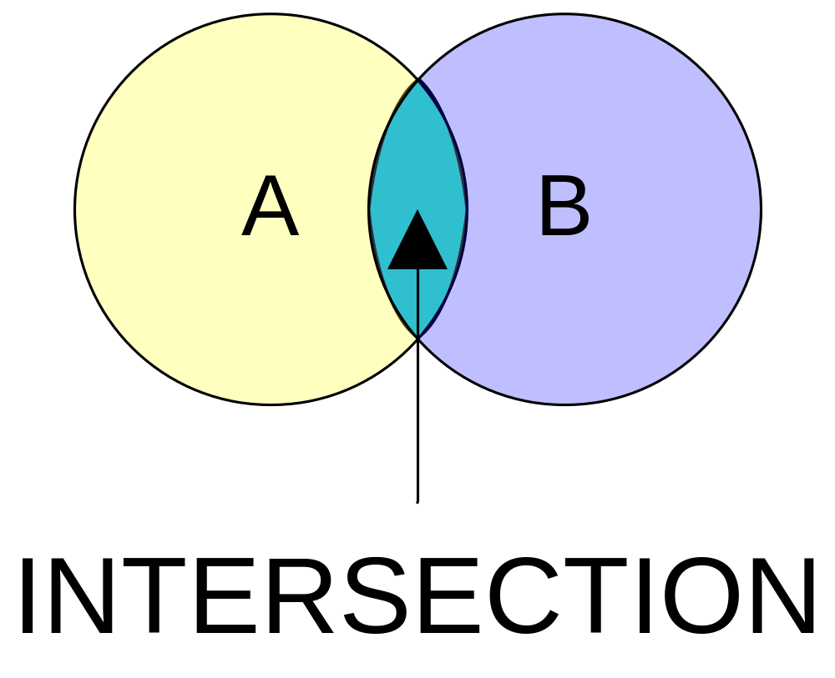
SQL Joins
Defining Join Types: INNER JOIN
Copyright 2006
Page <number>

Slide 4
SQL Joins
Defining Join Types: INNER JOIN
An INNER JOIN is also an equijoin, or equality join between equals.
An INNER JOIN matches on one or a set of columns values from one table:
  When one table is involved, an INNER JOIN creates an intersection between two copies of a single table (typically done with two different column names).
  When two or more tables are involved, an INNER JOIN creates an intersection between the tables based on designated column names.
Copyright 2006
Page <number>

Slide 5
SQL Joins
Defining Join Types: INNER JOIN
Oracle Syntax:
  You create an INNER JOIN by using an equality statement between two columns, or sets of two columns, between two copies of a table, or two tables, in the WHERE clause of a SQL statement.
  There is only one syntax for an INNER JOIN in Oracle Proprietary SQL.
  Equijoin resolutions are done by using an equality comparison between column values from two copies of one table or two table in the SQL WHERE clause, likewise this applies to sets of columns placed in the WHERE clause.
Copyright 2006
Page <number>

Slide 6
SQL Joins
Defining Join Types: INNER JOIN
ANSI SQL Syntax:
  You create an INNER JOIN by placing a position specific set of tables in the FROM clause followed by an ON or USING clause.
  Equality statements are between one or more columns in two copies of one table or two tables:
    When the columns share the same name and data type, you use the USING clause.
    When the columns have different names but the same data type, you use the ON clause.
  If only the word JOIN is used, an INNER JOIN is assumed by the SQL parser.
Copyright 2006
Page <number>

Slide 7
SQL Joins
Defining Join Types: INNER JOIN
Oracle Example:
  SELECT a.column1, b.column2
  FROM table1 a, table2 b
  WHERE a.columnpk = b.columnfk;
Copyright 2006
Page <number>

Slide 8
SQL Joins
Defining Join Types: INNER JOIN
ANSI SQL Example:
  SELECT a.column1, b.column2
  FROM table1 a [INNER] JOIN table2 b
  ON a.columnpk = b.columnfk;
Copyright 2006
Page <number>

Slide 9
SQL Joins
Defining Join Types: INNER JOIN
ANSI SQL Example:
  SELECT a.column1, b.column2
  FROM table1 a [INNER] JOIN table2 b
  USING(same_column_name);
Copyright 2006
Page <number>

Slide 10
SQL Joins
Defining Join Types: Natural Join
Is an equijoin or a match on one or a set of columns from one or more tables.
An equijoin creates an intersection based on columns with the same names.
Oracle Syntax:
  None exists.
ANSI SQL Syntax:
  You create an NATURAL JOIN by using the NATURAL key word.
  A NATURAL JOIN uses columns with the same name when they exist.
  A NATURAL JOIN returns a Cartesian product or CROSS JOIN when there are no matching column names.
Copyright 2006
Page <number>

Slide 11
SQL Joins
Defining Join Types: Natural Join
ANSI SQL Example:
  SELECT a.column1, b.column2
  FROM table1 a NATURAL JOIN table2 b;
Copyright 2006
Page <number>

Slide 12
SQL Joins
Defining Join Types: Non-equijoin
A non-equijoin is an indirect match:
  Occurs when one column value is found in the range between two other column values
  Uses the BETWEEN operator.
  Also occurs when one column value is found by matching against a criterion using an inequality operator.
Copyright 2006
Page <number>

Slide 13
SQL Joins
Defining Join Types: Non-equijoin
Oracle Example:
  SELECT a.column1, b.column2
  FROM table1 a, table2 b
  WHERE a.columnpk >= b.columnfk;
Copyright 2006
Page <number>

Slide 14
SQL Joins
Defining Join Types: Non-equijoin
Oracle Example:
  SELECT a.column1, b.column2
  FROM table1 a, table2 b
  WHERE a.cola BETWEEN b.colx AND b.coly;
Copyright 2006
Page <number>

Slide 15
SQL Joins
Defining Join Types: Non-equijoin
ANSI SQL Example:
  SELECT a.column1, b.column2
  FROM table1 a CROSS JOIN table2 b
  WHERE a.columnpk >= b.columnfk;
Copyright 2006
Page <number>

Slide 16
SQL Joins
Defining Join Types: Non-equijoin
ANSI SQL Example:
  SELECT a.column1, b.column2
  FROM table1 a CROSS JOIN table2 b
  WHERE a.column BETWEEN b.colx AND b.coly;
Copyright 2006
Page <number>

Slide 17
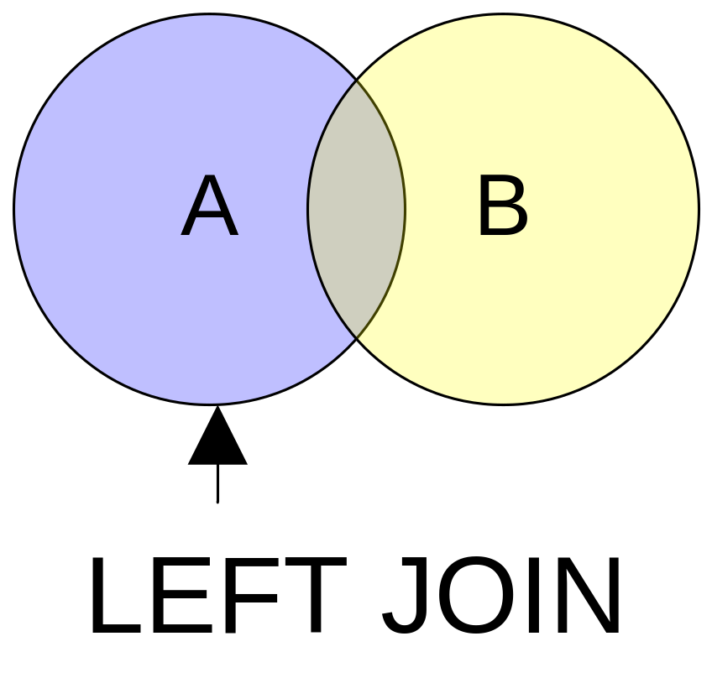
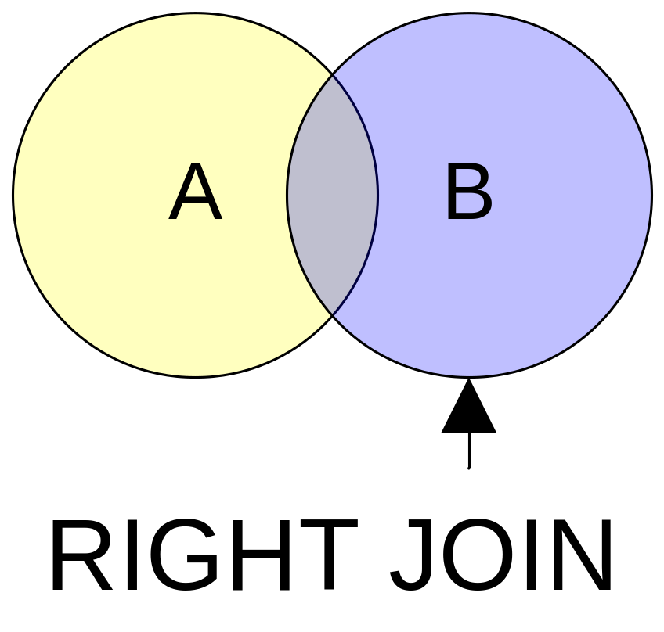
SQL Joins
Defining Join Types: Outer Join
Copyright 2006
Page <number>

Slide 18
SQL Joins
Defining Join Types: Outer Join
A match that includes all the matches between two copies of one table or two tables, and
All the non-matches from one copy of the single table, or one table of the two tables.
Copyright 2006
Page <number>

Slide 19
SQL Joins
Defining Join Types: Outer Join
Oracle Syntax:
  The “(+)” symbol is used to create an OUTER JOIN.
  When the “(+)” symbol is on the right of the join operand, it acts as the equivalent of a LEFT JOIN.
  When the “(+)” it is on the left of the join operand, it is the equivalent of a RIGHT JOIN.
Copyright 2006
Page <number>

Slide 20
SQL Joins
Defining Join Types: Outer Join
ANSI Syntax:
  These are defined by LEFT JOIN and RIGHT JOIN operators.
  Both LEFT [OUTER] JOIN and RIGHT [OUTER] JOIN are synonymous with LEFT JOIN and RIGHT JOIN respectively, the OUTER is assumed when left out.
  The OUTER keyword is optional or implicitly derived by the SQL parser.
  These join semantics are unidirectional outer joins and synonymous or alike behaviors because the only difference is the direction as to how their behavior is applied.
  The LEFT [OUTER] JOIN finds the non-matching values on the right-side of the operand.
  The RIGHT [OUTER] JOIN finds the non-matching values on the left-side of the operand.
Copyright 2006
Page <number>

Slide 21
SQL Joins
Defining Join Types: Outer Join
Oracle Example (left join):
  SELECT a.column1, b.column2
  FROM table1 a, table2 b
  WHERE a.columnpk = b.columnfk(+);
Copyright 2006
Page <number>

Slide 22
SQL Joins
Defining Join Types: Outer Join
Oracle Example (right join):
  SELECT a.column1, b.column2
  FROM table1 a, table2 b
  WHERE a.columnpk(+) = b.columnfk;
Copyright 2006
Page <number>

Slide 23
SQL Joins
Defining Join Types: Outer Join
ANSI SQL Example:
  SELECT a.column1, b.column2
  FROM table1 a LEFT JOIN table2 b
  ON a.columnpk = b.columnfk;
Copyright 2006
Page <number>

Slide 24
SQL Joins
Defining Join Types: Outer Join
ANSI SQL Example:
  SELECT a.column1, b.column2
  FROM table1 a RIGHT JOIN table2 b
  ON a.columnpk = b.columnfk;
Copyright 2006
Page <number>

Slide 25
SQL Joins
Defining Join Types: Full Outer Join
A match that includes all matches between two tables plus all non-matches whether on the left or right side of a join.
Oracle syntax: There is no full outer join syntax.
Oracle syntax: The UNION operator to mimic the behavior.
ANSI SQL synatx: Uses the FULL [OUTER] JOIN operator.
Copyright 2006
Page <number>

Slide 26
SQL Joins
Defining Join Types: Outer Join
Oracle Example:
  SELECT a.column1, b.column2
  FROM table1 a, table2 b
  WHERE a.columnpk(+) = b.columnfk
  UNION
  SELECT a.column1, b.column2
  FROM table1 a, table2 b
  WHERE a.columnpk = b.columnfk(+);
Copyright 2006
Page <number>

Slide 27
SQL Joins
Defining Join Types: Full Join
ANSI SQL Example:
  SELECT a.column1, b.column2
  FROM table1 a FULL [OUTER] JOIN table2 b
  ON a.columnpk = b.columnfk;
Copyright 2006
Page <number>

Slide 28
SQL Joins
Defining Join Types: Self Join
A recursive join internally within a single table based on a primary and foreign key residing in each row of data in a table.
You must use table name aliases to create a SELF JOIN.
Self joins typically use two separate column names.
Copyright 2006
Page <number>

Slide 29
SQL Joins
Defining Join Types: Self Join
Oracle Example:
  SELECT a.column1, b.column2
  FROM table1 a, table1 b
  WHERE a.columnpk = b.columnfk;
Copyright 2006
Page <number>

Slide 30
SQL Joins
Defining Join Types: Self Join
ANSI SQL Example:
  SELECT a.column1, b.column2
  FROM table1 a [INNER] JOIN table1 b
  ON a.columnpk = b.columnfk;
Copyright 2006
Page <number>

Slide 31
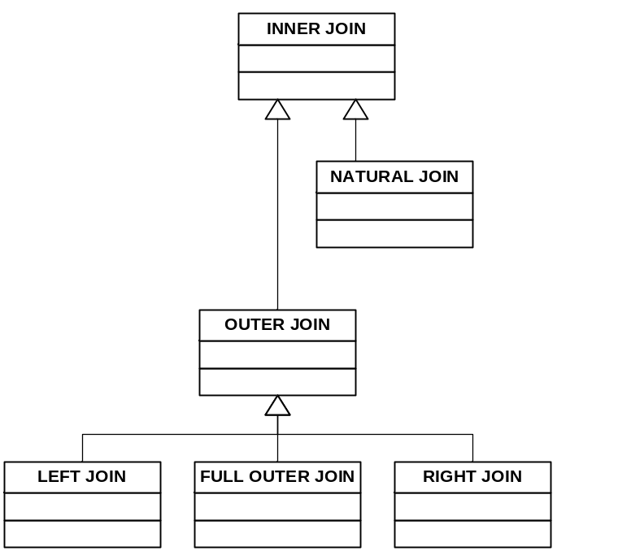
SQL Joins
Defining Join Types: Inheritance
Copyright 2006
Page <number>

Slide 32
Summary
Inner join or equijoin
  Surrogate keys
  Natural keys
Non-equijoin
Outer join
Full outer join
Self join
Join behavior inheritance tree
Copyright 2006
Page <number>

